Slide 1

Taxi Driver Application
Gabe Isaacs, Benjy Katz, Jonathan Wenger

Slide 2
The Problem

Slide 3
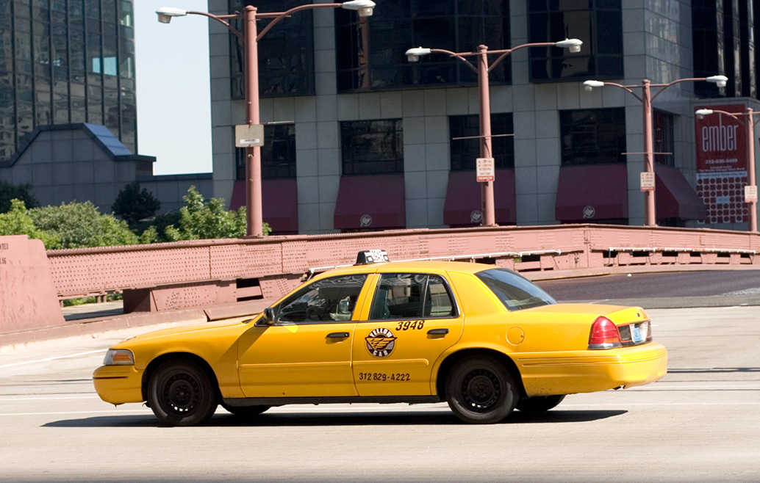
Problem Statement
As of August 7th, 2019: “[Taxi] drivers spend 41% of their time in Congestion Zone cruising ¹”
Often cab drivers (even Uber drivers) will aimlessly drive until they get flagged down, or until someone needs them in a specific location
Cab drivers make on average $25 an hour, but this is only for the hours that they have passengers.² This means if a driver works 10 hours, he is losing over a $100 a day
¹ https://www.nyc.gov/assets/tlc/downloads/pdf/proposed_rules_hvfhs_cruising_08_07.pdf
² https://www.indeed.com/career/taxi-driver/salaries/New-York--NY
Notes:
Benjy Jonathan and I are working on an exciting project that could revolutionize the way cab drivers operate in our city

Slide 4
Solution

Slide 5
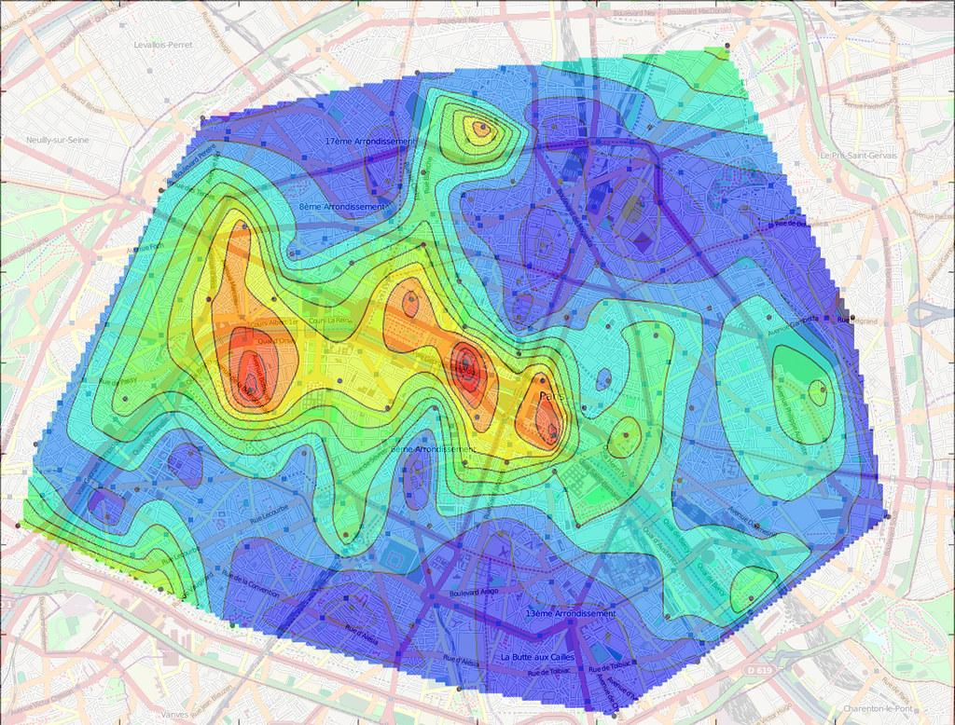
Desired Outcome
The Goal of our project is to address this problem that cab drivers face
Side benefit helping customers get cabs more quickly
We would like to create a heatmap throughout the city that allows drivers to know where is the best place to be minimizing cruising time
Using ML Techniques, such as Neural Networks or Linear Regression, our project will be able to enhance the efficiency of cab drivers throughout any given city

Slide 6
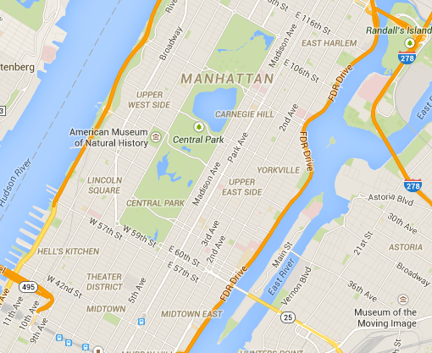


How we did it
Step 1 Step 2 Step 3
EDA and Data cleaning Modeling Front-end/UI

Slide 7


How we did it
Step 4 Step 5 Deployment Application

Slide 8
EDA

Slide 9
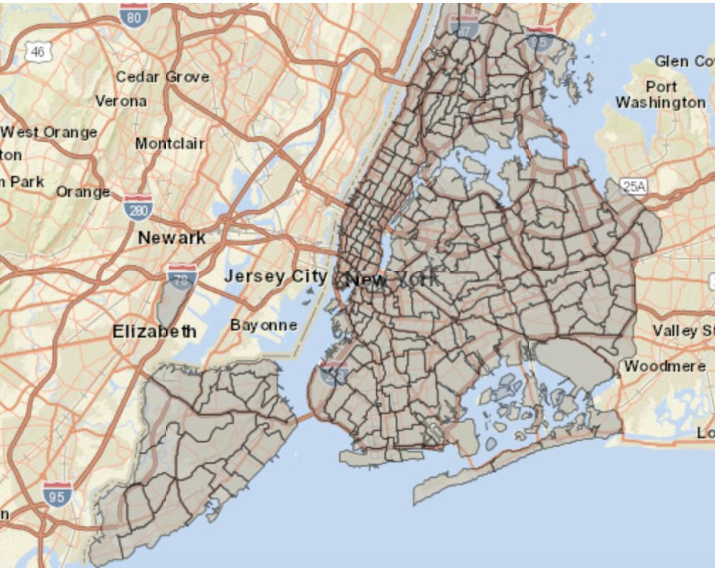
NYC Taxi Zones

Slide 10
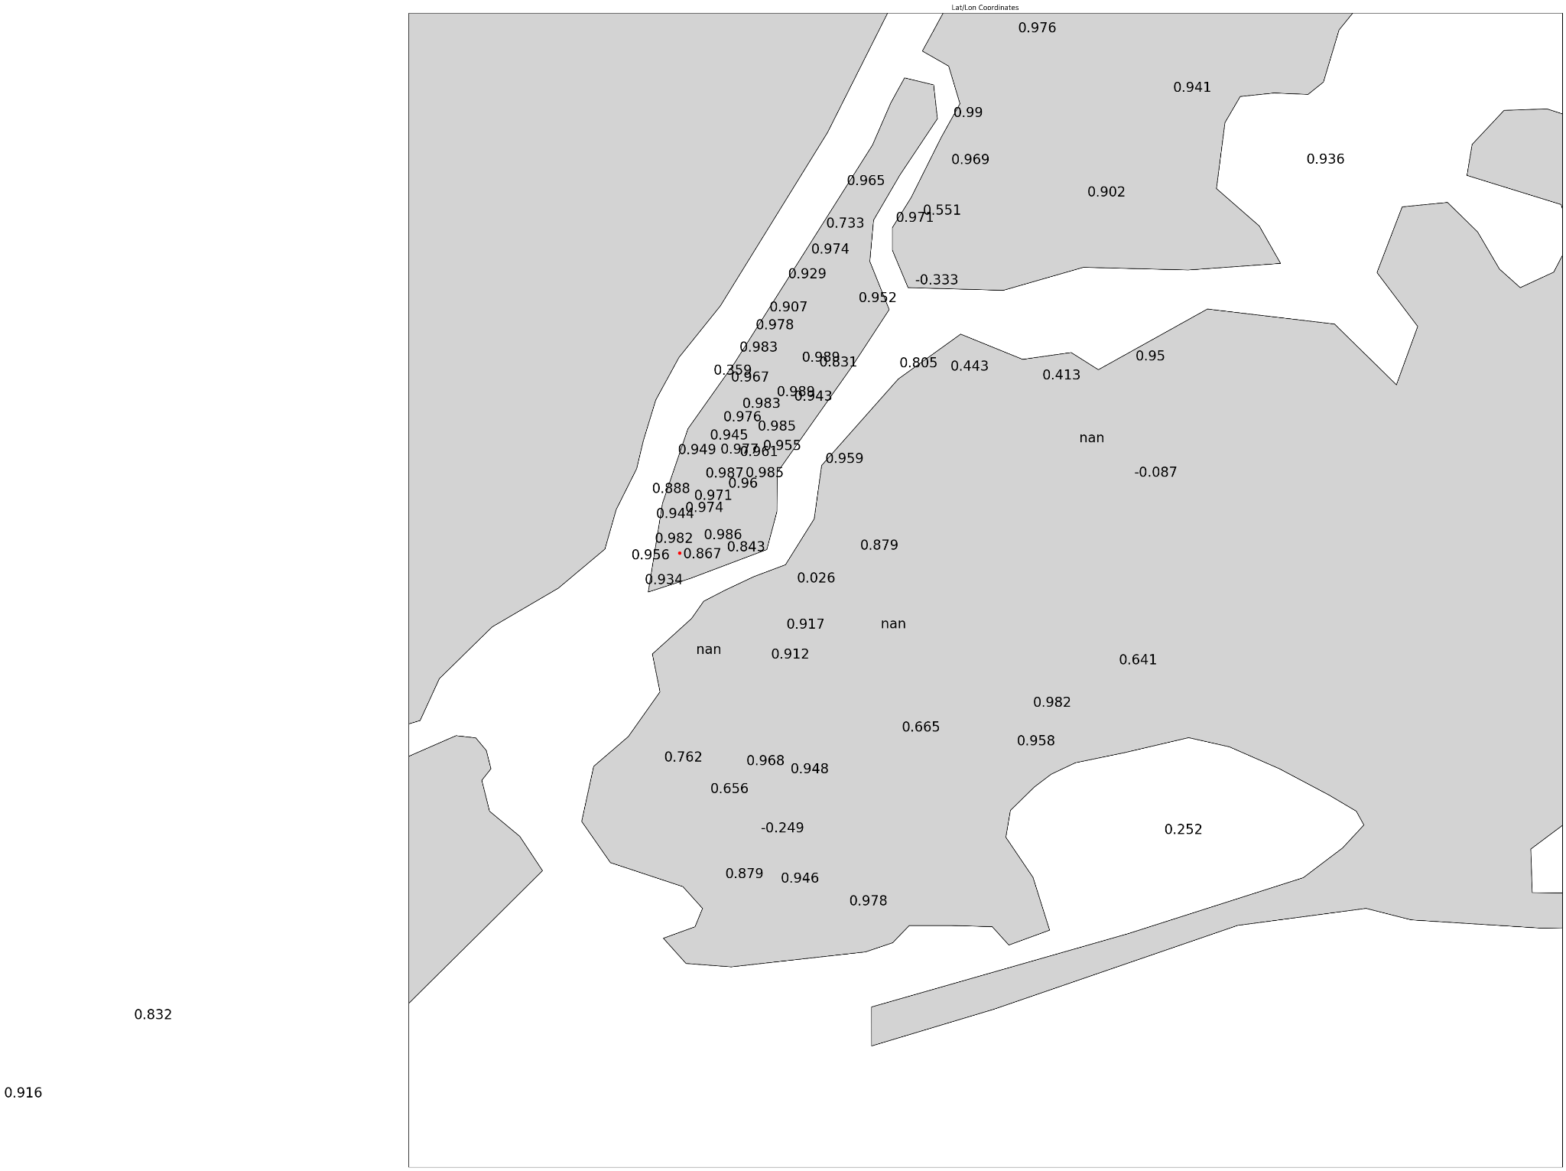
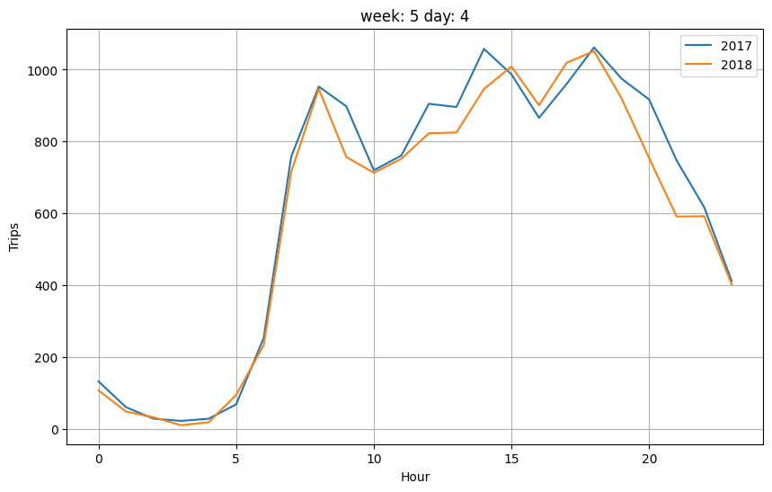
Historical Correlation
Pearson correlation coefficient

Slide 12
Modeling

Slide 13
Final Model Design
Zone
Week, Day, and Time
This year Demand
-Standard Regression DNN
-Loss based on MSE
-3489 Trainable Parameters
-Trained in Batches
Last years Demand
This year Price
Last years Price
This year Duration
Last years Duration

Slide 14
Model Results
Model | Mean Squared Error
Baseline Historical | 4405
DNN sparse | 2468
LSTM | 1951
DNN dimensionality reduction | 791
DNN historical | 230

Slide 15
Application

Slide 16

Application: Back End
Flask Application
2 Endpoints
“/historical” - 2022 Data
“/predictive” - ML Model
One Parameter - Date/Time
Example - http://127.0.0.1:5000/historical?datetime=2024-05-01T17:46:00

Slide 17
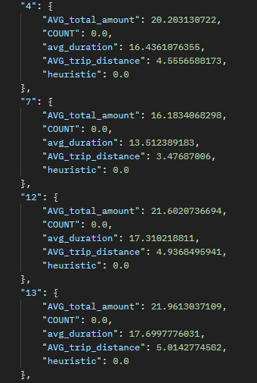
Application: Back End
Returns a JSON
Partial Example of response:

Slide 18

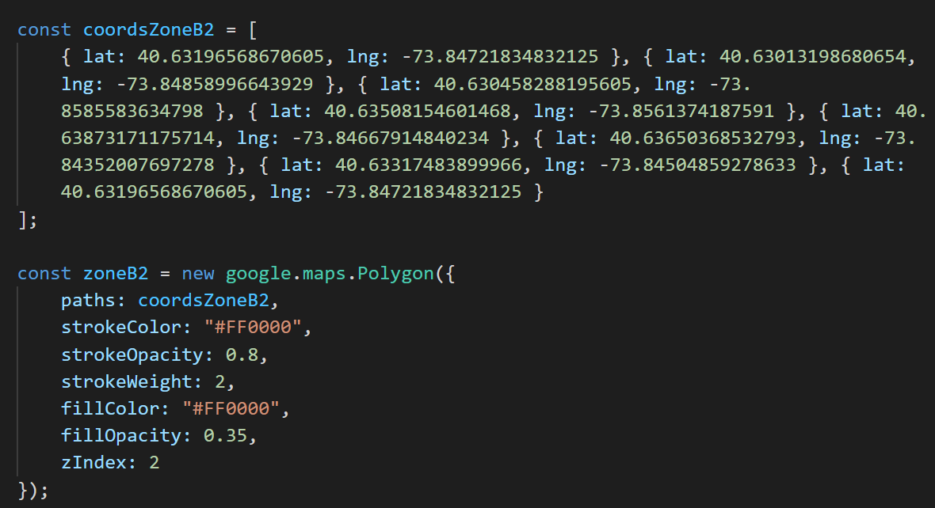
Application: Front End
Node.js with Typescript
Google Maps API to display map for user
Python script to convert latitude/longitude information from NYC Data to be used as coordinates for Google Maps Polygons
Sample coordinate Information for zone in Typescript

Slide 19
Application: Front End
Every 30 seconds, Flask application gets called with current date/time
JSON gets parsed and saved
Colors update based on user preference
2 Models:
Historical (2022 Data)
Predictive (ML Model)
5 Coloring Options from that zone (red being worst, green being best, grey meaning no data):
Highest Price
Longest Duration
Longest Distance
Number of Taxis
Heuristic (which is ((Price/Duration)*Number of Taxis))

Slide 20
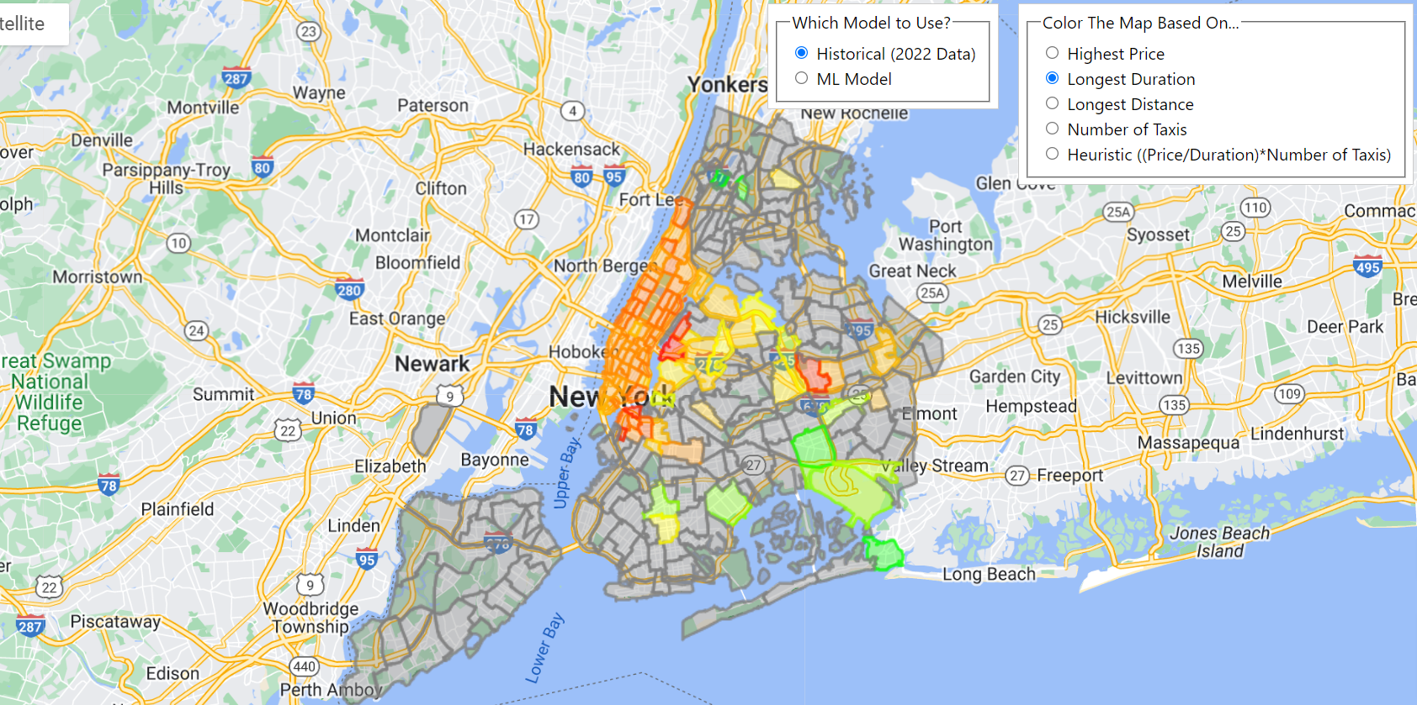
Sample Screenshot of Application

Slide 21
Deployment

Slide 22
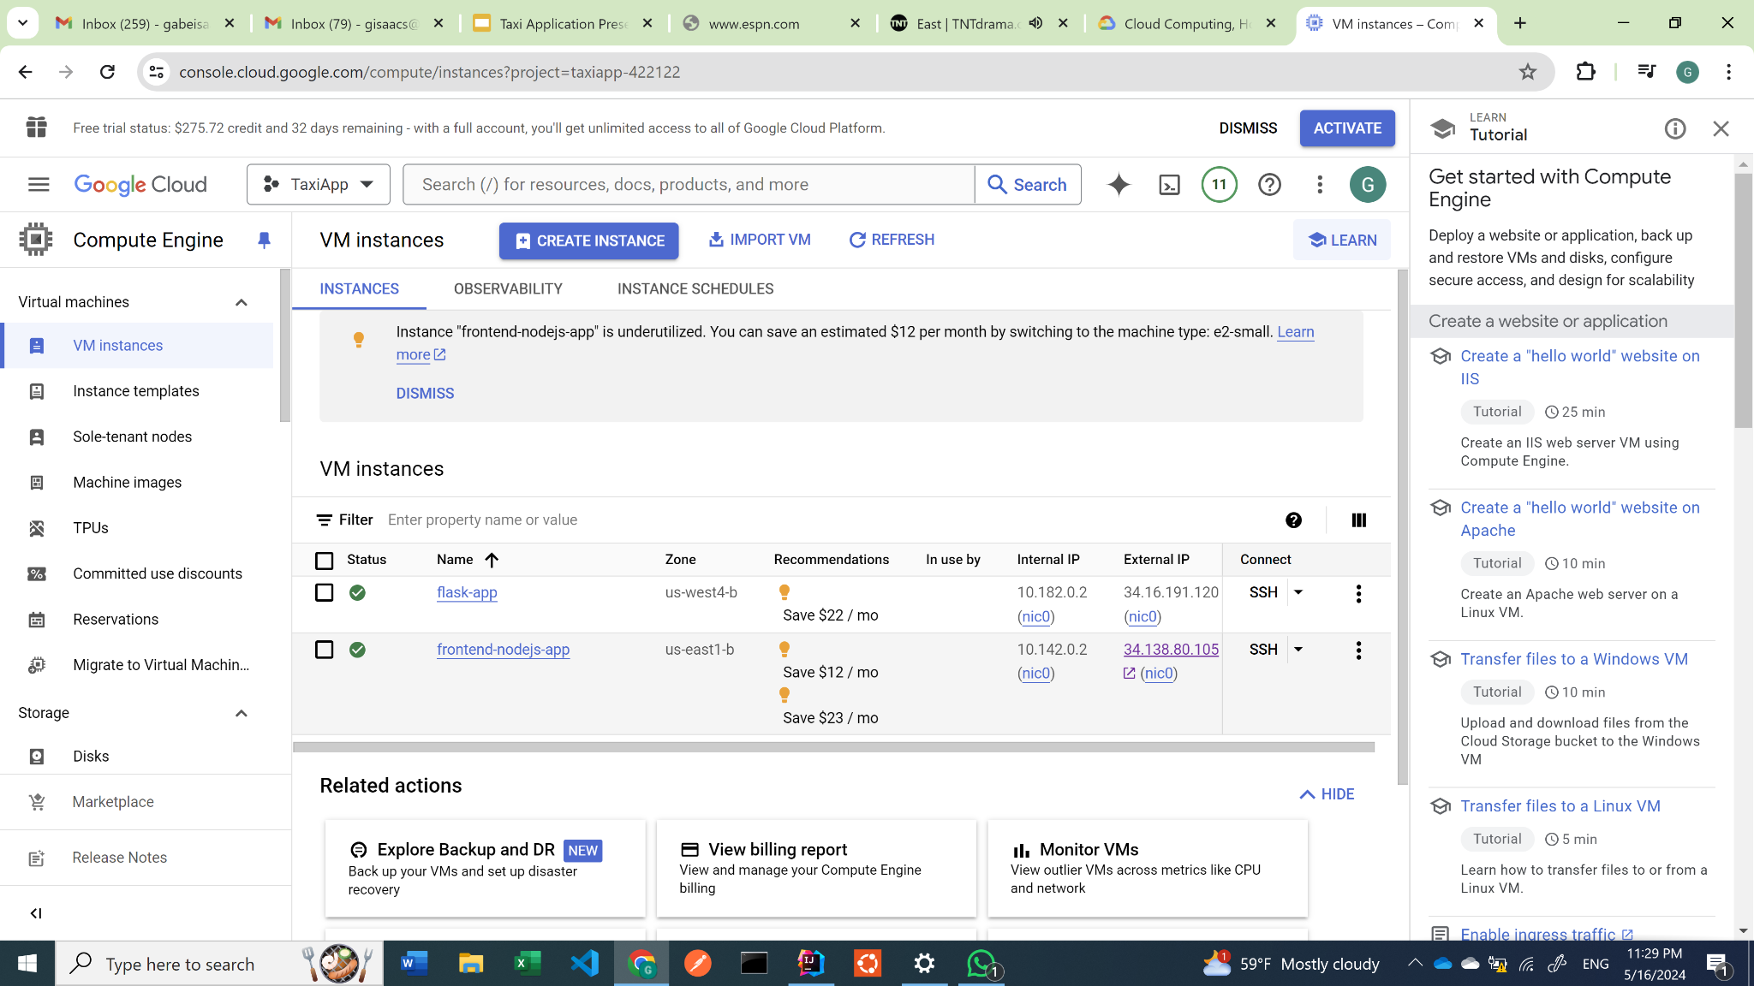

Slide 23
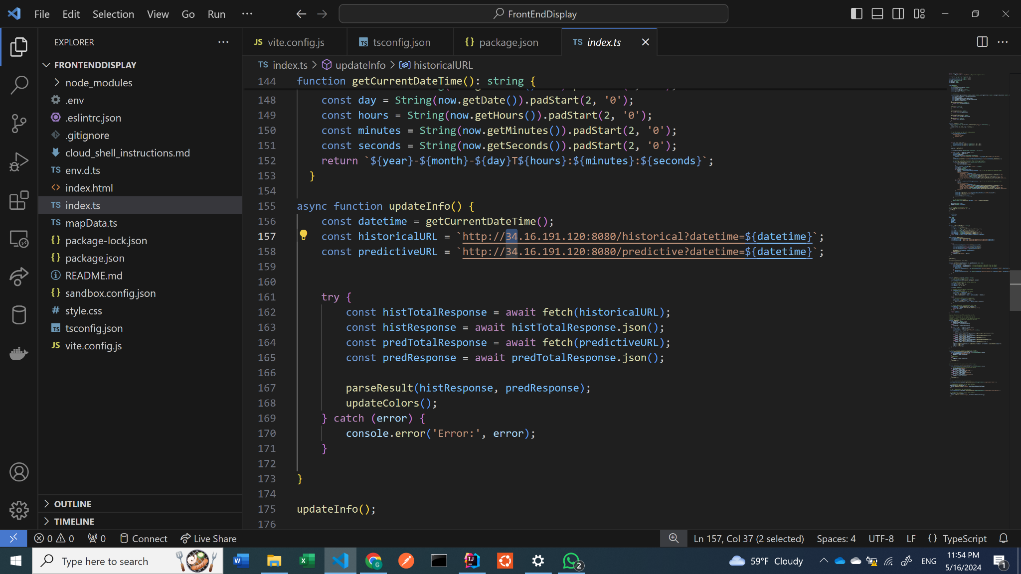
Sample of deployment backend up and running

Slide 24
Demo
bit.ly/TaxiHeatMap

Slide 25
Future Improvements

Slide 26

Future Improvements
Take driver’s current location to give detailed information on where they currently are
Driver feedback
Driver chooses what to maximize on
Overloading issues

Slide 27
Thank You!
Questions?

